Slide 2
CAT-MARIO SCRTCH GAME
A Funny Adventurous game
Presented by:
NOUMAN AHMED
HASSNAIN HUNNY
ABSHAR HUSSAIN

Slide 3


Slide 4

Cat-mario

Slide 5
go and save your queen
Before someone else grab it

Slide 6
introduction
The basic concept of mario games is that the character of game have to reach the final destination.there are many hurdles in it’s way.the specific character of the game should reach to the final destination(winning point).

Slide 7
Concept of the two player version
The concept of two player version us that at first it is start by only one player.in beginning the first player starts the game and reach to final point.
then,second player start the game and reach to final point.
The timer will start as both players start the game.
After,there is comparison between the time.
The player who will reach the destination on less time will win the game.

Slide 8
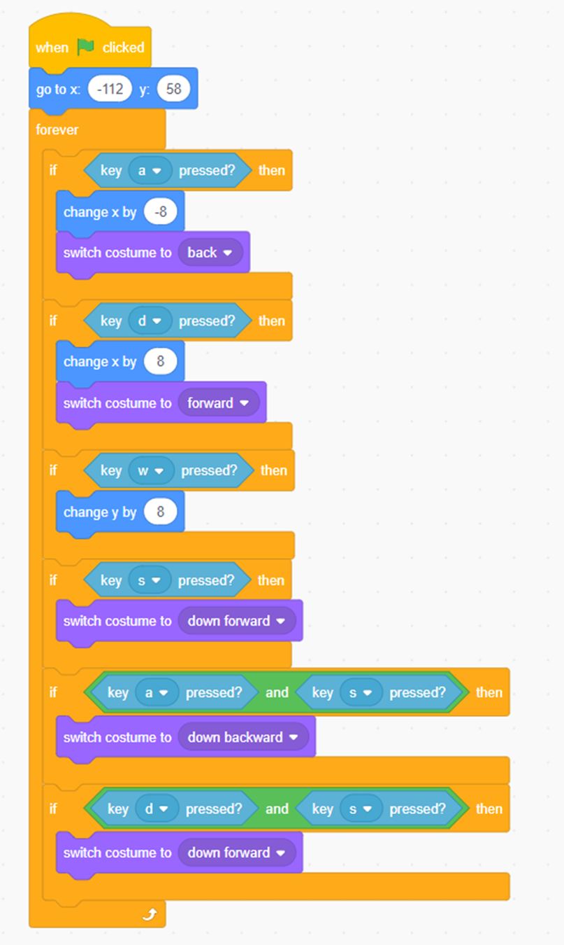
Controls
Defining our character control system
There are two sprites of cat having the different colors.
The movement of cat can be control by using the keys a,s,d,e respectively.

Slide 9
Sprite switching
As the cat begins to its destination,the sprite of the ground also changes.
Here,I use eight ground sprites in it.
The sprite eventually changes as is hits some specific color in respective ground sprite.

Slide 10
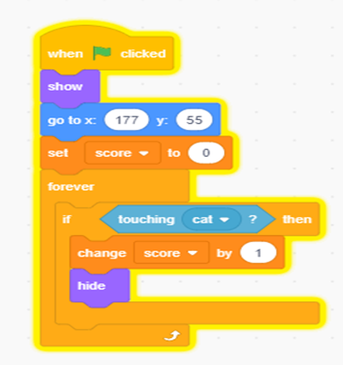
Scoring system
Here is the scoring system to check weather a sprite is able to go on final stage
The cat sprite will only move to the final stage if the total score of cat is equal or more than seven
When the star is touched,the score will increase by one

Slide 11
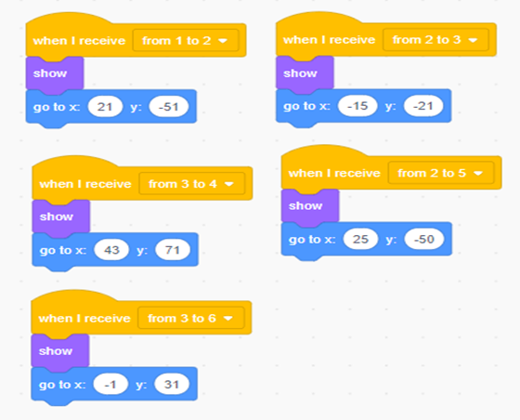
This condition is only applicable on first ground
The condition for the other ground is defined as

Slide 12

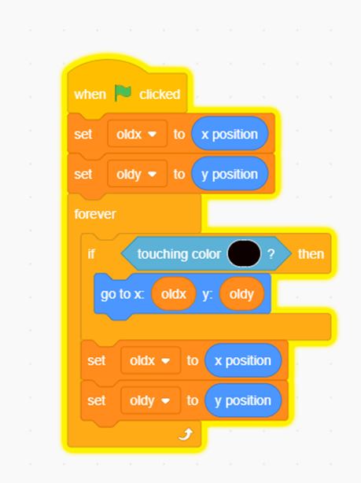
Boundary touching condition
We use the black color as the boundary touching condition.
As the cat sprite hits the black color of ground sprite,it will not go through the wall as is specified for ground

Slide 13
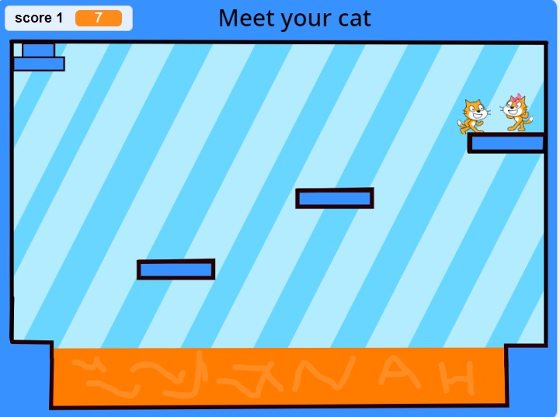
Jumping of heroin cat
As the cat sprite reach to final stage,the heroin cat starts jumping by seeing the cat coming towards her.
As the male cat grap his heroin cat,the game overs for one player and started for second player

Slide 14
Gravity controller
Without gravity,the the game concept does’nt exist.
Gravity controller play a key roe in game.
It stabilize the cat in the air or in the ground as it moves in any direction.
Gravity controller holds the core concept of the game.

Slide 15
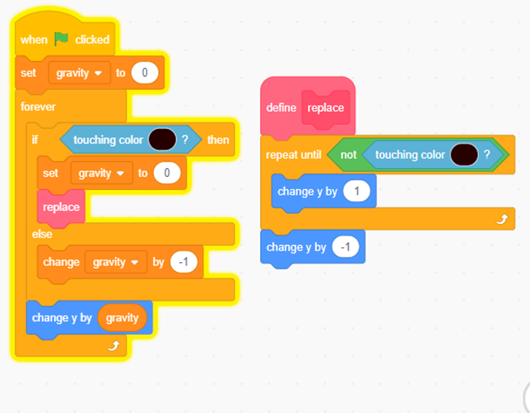
The value of gravity remains zero as long as the cat remain in touch with specific color(floor).
The value will change by -1 as the cat moives in the air.we will change the value of y variable with respect to gravity

Slide 16
Moving from one ground to another
The most difficult and time talking task Is to switch ground from one to another ground
We use the different color schemes to overcome many problems
We define the placement of cat when the specific color is touched by the cat.

Slide 17
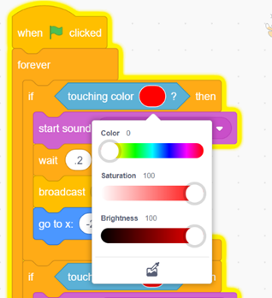
That are different color schemes we used to define the ground
We can see in this we use the spefic color at the end of sprite
color 0
saturation 100
brightness 100

Slide 18
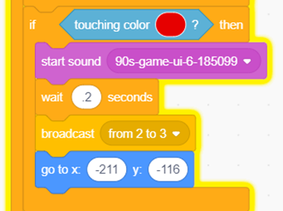
Similarly we use the color scheme to move from one ground to another ground.
When it hits the color in present ground ,that’s mean the sprite completed the current ground and it wants to move in another ground

Slide 19
WINNING CONDITION
WINNIG CONDTION OF THE BOTH PLAYERS DEPENDS ON THE TIME
THE TIME COMPARISON BETWEEN BOTH OF THE PLAYERS WILL DECIDE THE WINNER
HERE WE USE BROADCAST FEATURE IN THE CODE

Slide 20
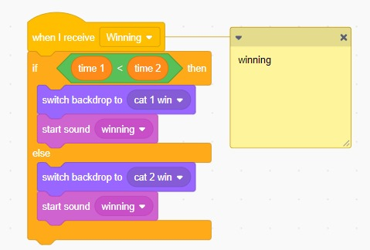
WHEN THE TIME COMPARISON IS TAKEN,THE PLAYER THAT REACHES THE QUEEN IN LESS TIME IS THE WINNER

